Slide 1


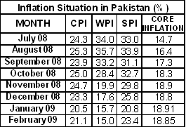
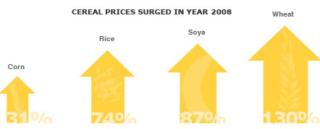
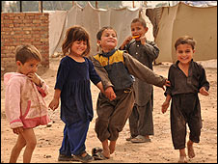
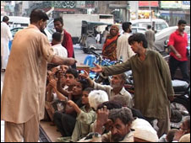

EFFECTS OF INFLATION ON PURCHASING POWER OF PEOPLE IN PAKISTAN
MUHAMMAD EHTISHAM UL HAQ Registration no. 51738
PROJECT ADVISER:
FARHAN UL HAQ USMANI
INTRODUCTION
. DUE TO INFLATION PURCHASING POWER OF PEOPLE DECREASES AND EFFECT ECONOMIC GROWTH
METODOLOGY
. STRATIFIED RANDOM SAMPLING
. 125 SAMPLES
Inflation Situation in (%)
MONTHS | CPI | WPI | SPI | CORE INFLATION
July 08 | 24.3 | 34.0 | 33.0 | 14.7
August 08 | 25.3 | 35.7 | 33.9 | 16.4
September 08 | 23.9 | 33.2 | 31.1 | 17.3
October 08 | 25.0 | 28.4 | 32.7 | 18.3
November 08 | 24.7 | 19.9 | 29.8 | 18.9
December 08 | 23.3 | 17.6 | 25.8 | 18.8
January 09 | 20.5 | 15.7 | 20.8 | 18.91
February 09 | 21.1 | 15.0 | 23.4 | 18.85
OBJECTIVE
. MEASURE EFFECT OF INFLATION ON DIFFERENT INCOME LEVEL GROUPS
CONCLUSION
. BOTH DEMAND PULL AND COST PUSH FACTORS ARE RESPONSIBLE FOR CURRENT INFLATION
. MOST HURT ARE THE LOWER INCOME SEGMENTS OF THE SOCIETY FOLLOWED BY THE MIDDLE INCOME GROUP

